Slide 1
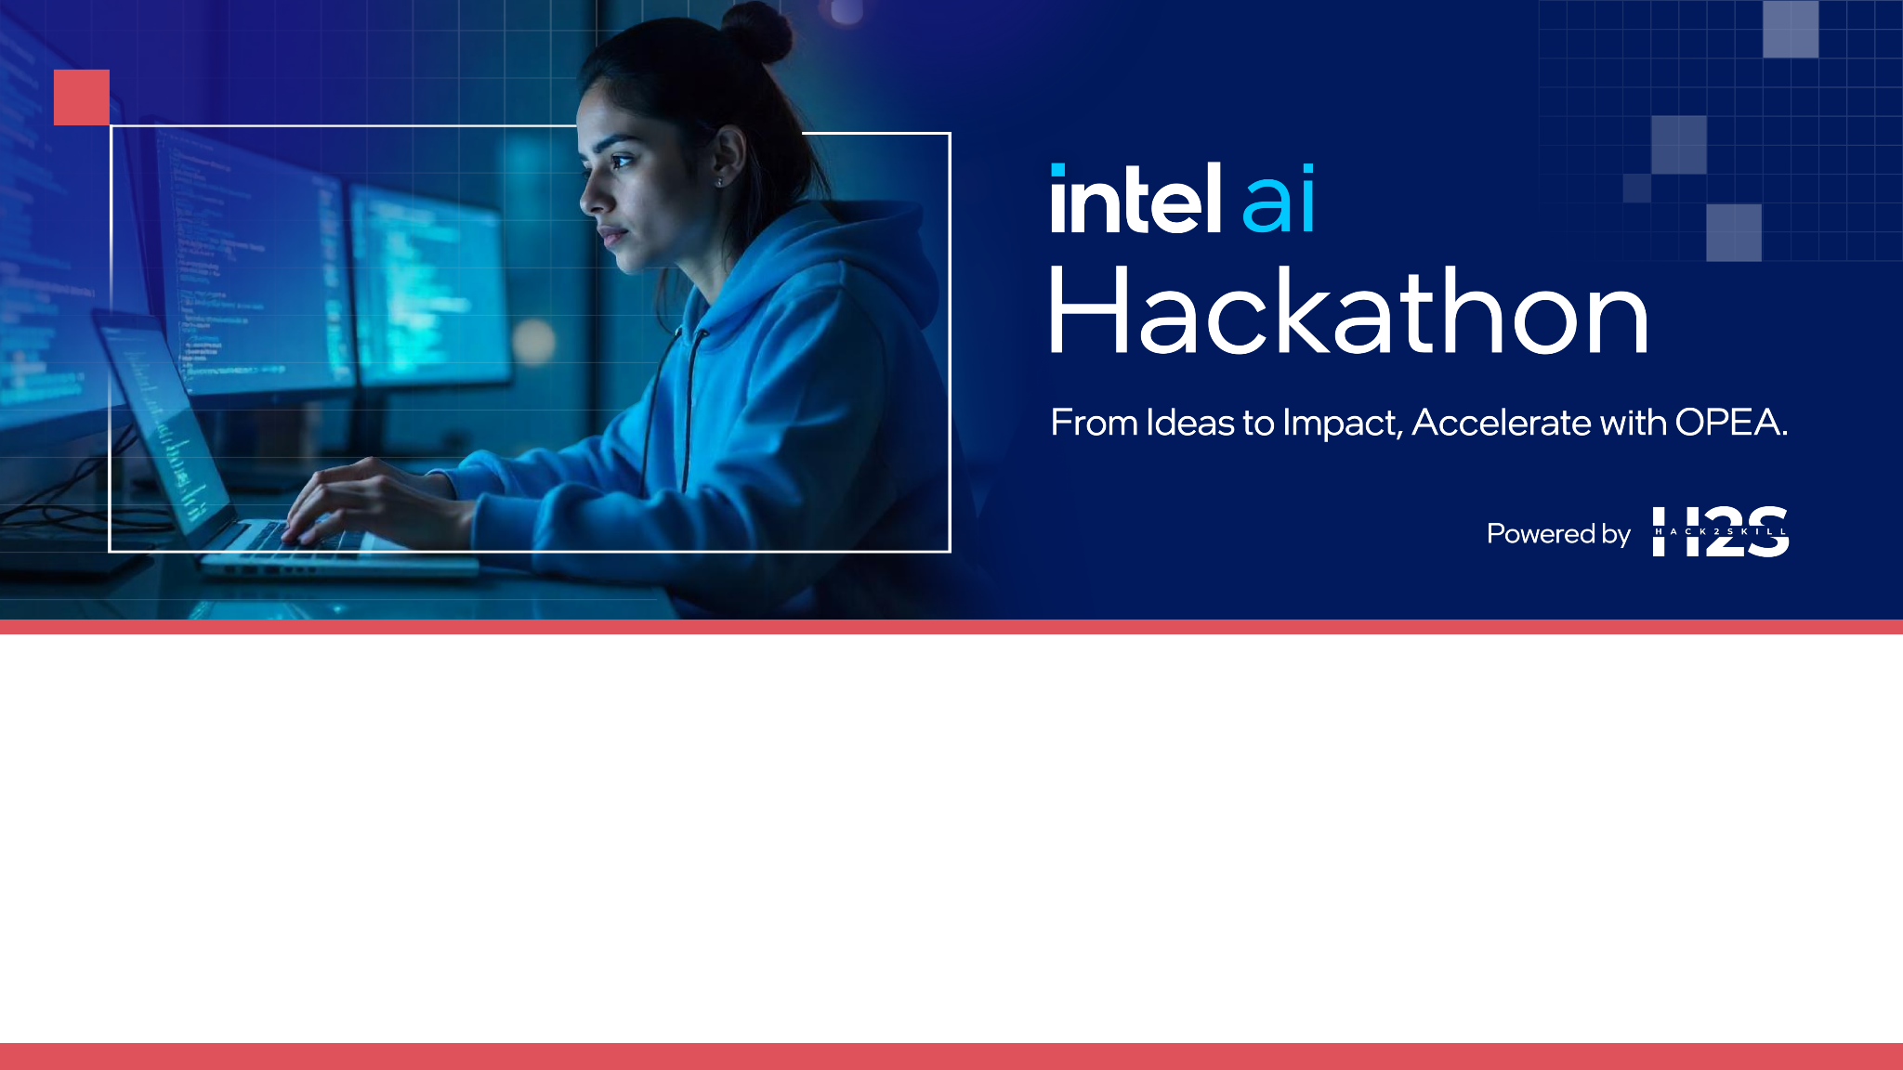

Team Name: unnamed_v2 🧑‍💻
Team Leader Name: Ratul Pal
Theme: Smart Workplace Assistant🪄

Slide 2


Team Members
Ratul Pal
Sumit Kumar
Prateek Ralhan

Slide 3
Brief About the Solution
🎯Objective:
To empower visually impaired individuals to query, comprehend and analyze visual content (images, videos, surroundings) using an intuitive, voice-driven interface backed by multimodal AI -> Pyxis 🚀.
🛠️ How it works:
User speaks a query related to their visual environment or static image/video feed.
System performs ASR → Vision analysis → LLM-based Q&A (reasoning models) → Speech response
Uses both real-time camera feeds and static content (images/videos)
Key Capabilities:
✅ Real-time vision understanding ✅ Multimodal reasoning (text + vision + speech) ✅ Voice-based interaction & feedback ✅ Deployable on Intel Edge Devices/cloud infrastructure!

Slide 4
Motivation/Stats/References
💡 Blindness affects over 253 million people globally (WHO) – https://pmc.ncbi.nlm.nih.gov/articles/PMC5820628/ 📊 90% of visually impaired people live in low-income settings – https://www.disabled-world.com/disability/types/vision/#:~:text=Over%2090%25%20of%20those%20with%20vision%20loss%20live,do%20not%20have%20access%20to%20eye%20care%20services
🧭 Navigating and understanding visual context is a daily challenge – https://www.jessejacquesphoto.com/post/the-essential-skill-of-visual-literacy-a-guide-to-understanding-visual-content
Enabling independent visual understanding through accessible and low-cost multimodal AI can significantly enhance quality of life, aid in education, mobility, and information access for the visually impaired.
Recent breakthroughs in multimodal LLMs (Mistral, LLaMA, BridgeTower, OpenAI Whisper) make contextual visual reasoning possible!
With Pyxis 🚀, we bring the power of multimodal AI to the visually impaired – so they can ask, understand and respond to the world around them, independently!

Slide 5
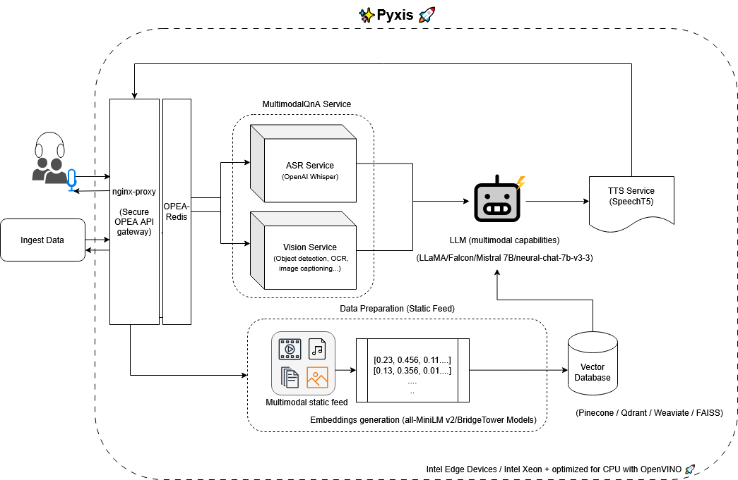
System Architecture
🎨 Designed using: https://app.diagrams.net/

Slide 6
Tech Stack
🔧 OPEA Platform: (API Gateway (nginx-proxy), Redis Broker (opea-redis))
🧠 LLMs: LLaMA, Falcon, Mistral, Neural Chat 7B
🎤 ASR: OpenAI Whisper
👁️ Vision: Object Detection, OCR, Image Captioning
🔊 TTS: SpeechT5
📦 Embeddings: all-MiniLM v2, BridgeTower
🧠 Vector DB: Pinecone / Qdrant / Weaviate / FAISS
⚙️ Intel Edge Devices: (Xeon CPUs) with OpenVINO toolkit for accelerated CPU inference

Slide 7
Assumptions
⚠️Input Modality: User provides spoken queries; system assumes device has microphone access.
⚠️Edge Constraints: Solution designed for low-latency edge inference.
⚠️Vision Feed Availability: System assumes access to either a live camera or uploaded/stored visual content.
⚠️Use Case Scope: Prioritizing general object understanding, text extraction, and scene explanation.

Slide 8
OPEA platform and microservices usage
How OPEA powers Pyxis 🚀:
🛠️ API Gateway (nginx-proxy), Redis Broker (opea-redis): Ensures secure, scalable microservice orchestration, acts as load balancer and prevents overuse/abuse of API calls
🛠️ ASR Service (OpenAI Whisper): Converts speech to text
🛠️Multimodal LLM (LLaMA, Falcon, Mistral, Neural Chat 7B): Processes combined text + vision context for Q&A
🛠️ Vision Service: Object Detection, OCR (text in images), Image Captioning
🛠️ TTS Service (SpeechT5): Responds to the user in natural speech
🛠️ Embeddings (all-MiniLM v2, BridgeTower) + Vector Search (Pinecone / Qdrant / Weaviate / FAISS): Enables semantic context matching
🛠️ Edge Optimization: OpenVINO models run efficiently on Intel Xeon processors

Slide 9
Novelty and Expected Results
🧪 Novelty:
End-to-end multimodal flow (speech → vision → LLM → speech)
Optimized for edge deployment (real-time on low-cost hardware)
Built entirely using OPEA-compliant microservices
Modular architecture enabling plug-and-play enhancements
🎯 Expected Results:
~90% ASR + vision Q&A accuracy on benchmark visual datasets
End-to-end latency under 2s on Intel Xeon edge servers
Positive User feedback (pilot testing with visually impaired users)

Slide 10
